Slide 1
Muhammad Danyal Rana
FA22-BCS-057
Notes:
This is my first slide of PowerPoint.

Slide 2
Lab-2 (Activty-8)
Games
WarCraft II
Diablo II
System Shock
Hardware
Software
Application Software
System Software
Notes:
This is my second slide of PowerPoint.

Slide 3

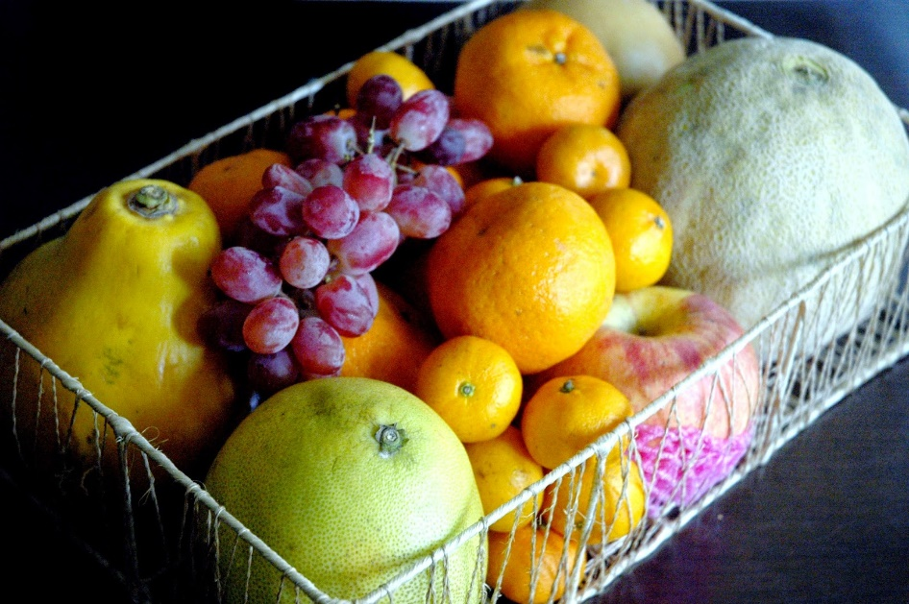
Inserting Images
Computer Scientist
Fruits

Slide 4
Hyperlink
In Slide #3, we have inserted the images.
If you want to know more about Computer Science, Click here.
If you want to know more about PowerPoint, Click here.
If you want to know about Hyperlinks, Click here.

Slide 5
Activity-15 (Photo Album)

